Slide 1
Customer Analysis using Base SAS
Chiranjeeva
Salihdeen
Surendar
Vigneshwaran

Slide 2







Amazon
Barnes and Noble
Understanding the data
40,000 purchase records is converted to 9451 user records
73% of missing education data is imputed using mode (4)
3 missing age data is imputed using mode (6)
46 missing region data is imputed using mode (3)
Domain flag created 1: Barnes and Noble 0: Amazon
80.8% users bought only from Amazon
13.5% users bought only from BN
5.6% users bought from both sites

Slide 3
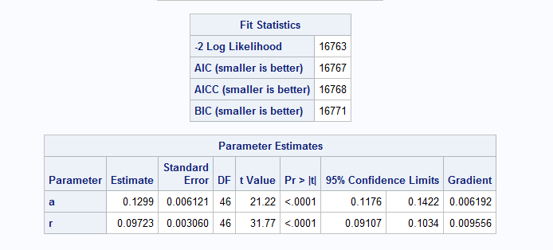
NBD Model
MLE = 16763/2
= 8381.5

Slide 4
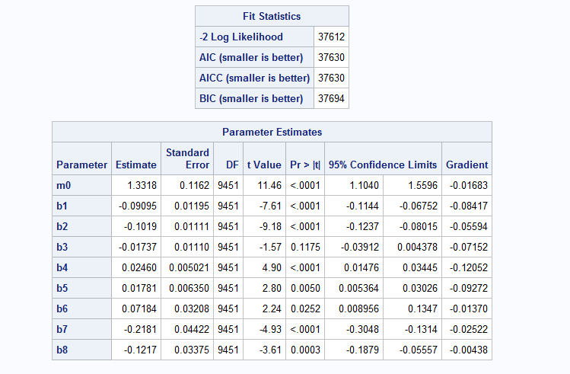
Poisson Model
MLE = 37612/2
= 18806
P-value > 0.05

Slide 5
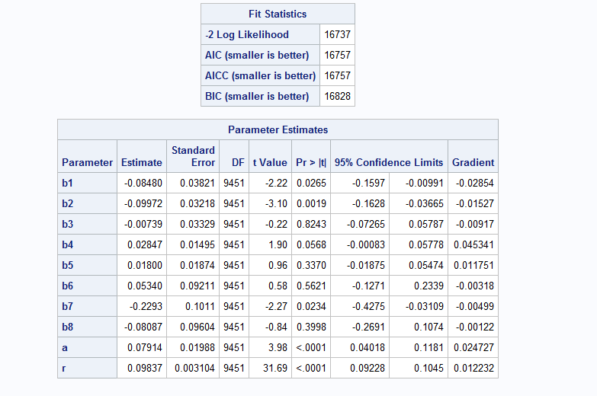

NBD Regression Model
MLE = 16737/2
= 8368.5
P < 0.05
Language?

Slide 6

Model selection
H0: Model A is not different from Model B
H1: Model A is different from Model B
LR = -2 (LLB* – LLA*)
LR = 37612 – 16737
LR = 20875
LR > χ2 (.05,k)
20875 > 15.5
Based on LR test results we conclude that NBD model is better than Poisson
* LLA – Log Likelihood of NBD
* LLB – Log Likelihood of Poisson

Slide 7
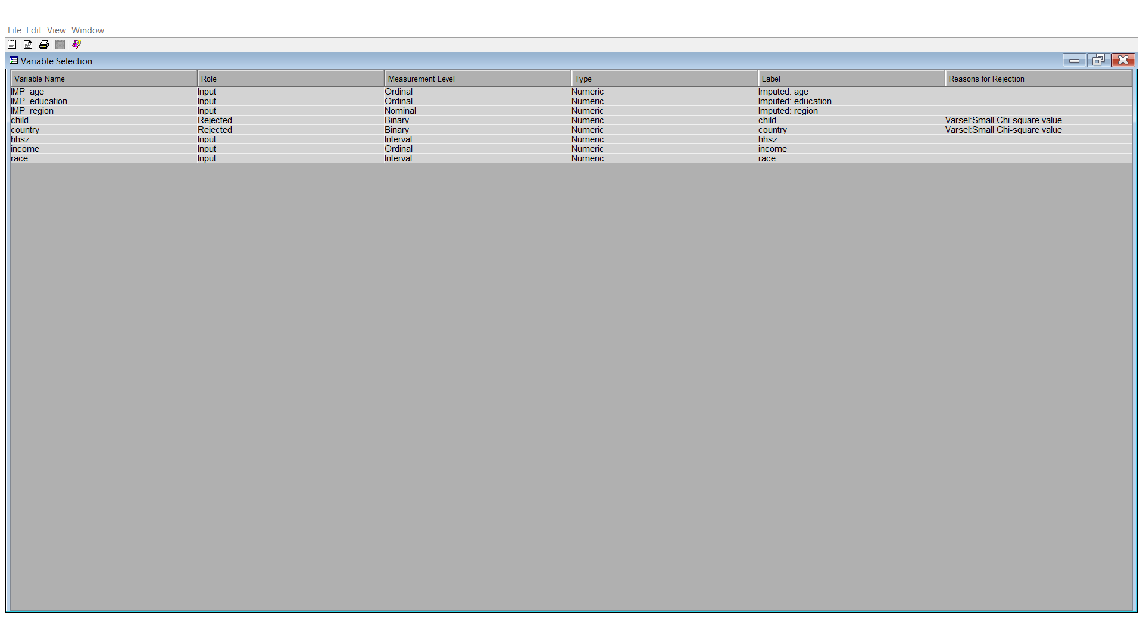
Variable selection
Missing values: 73%

Slide 8


Improving NBD Regression
Four variables
Weekend
Weekday
Season
Degree of loyalty
Model performance decreased with weekend, weekday & Season
With the addition of Degree of loyalty to the mix our performance improved.

Slide 9
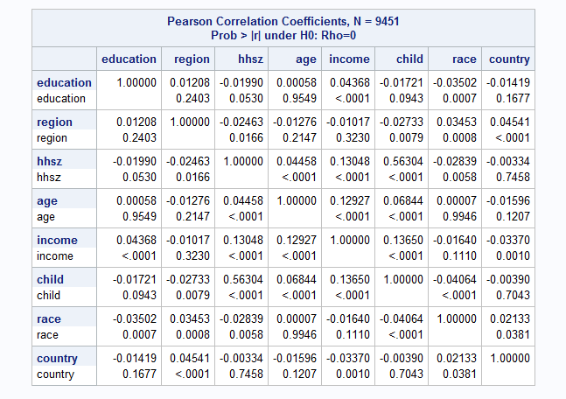

Interaction Effect
MLE Results:
Age and Income:16743/2 = 8371.5
Age and household: 16743/2 = 8371.5
Household and income: 16743/2 = 8371.5

Slide 10
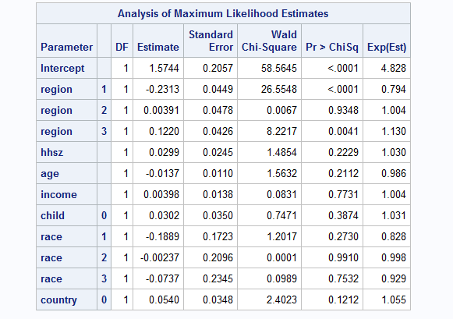
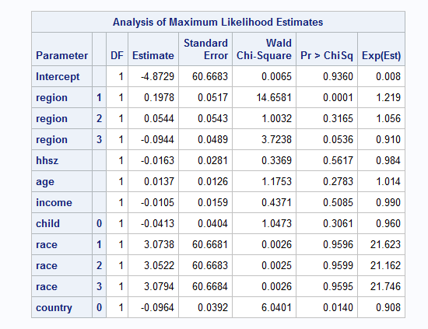
Logistic regression
BN over Amazon
Amazon over BN

Slide 11
Summary
96% of the BN users were from race category 1
Number of users who bought more books from BN compared to Amazon is < 2%
BN can improve their market share by
Securing exclusive book deals from reputed authors
Encouraging young authors to increase the catalog
Better advertising

Slide 12
Thank You!

